Slide 1
Advanced Survival Analysis
Part #3
Dr Oliver Perra
Full resource: https://www.ncrm.ac.uk/resources/online/all/?id=20860

Slide 2
Outline: Cox Regression Model
Model characteristics: Semi-Parametric
Risk scores and methods to recover the baseline function
Relaxing model assumptions: Time varying effects of predictors

Slide 3
Recap
Cox Regression Model:
  Estimates the log of the negative log survivor function (i.e.: log of the cumulative hazard function).
  Mathematical relationships mean the model can be expressed in terms of estimated cumulative hazard and estimated raw hazard.
  Key assumptions:
    A fitted log hazard function for each value of the predictor;
    Fitted log hazard functions have an identical shape;
    The distance between log hazard functions is identical at every possible interval.

Slide 4
Cox Regression Model: Semi-Parametric
The shape of the baseline hazard function is irrelevant
 | Coef. | Exp(coef.) | SE Coef. | z | p
Male | 0.53 | 1.70 | 0.17 | 3.18 | .001
Notes:
I will start by highlighting that the Cox regression model is semi-parametric.
What it means is that the model makes fewer parametric assumptions on the phenomena of interest than parametric models.
A key characteristic of the Cox model, which I mentioned in the previous presentation, is that the model does not make assumptions on the baseline hazard function. All that the model does is estimate the predictors’ effects on the baseline function. Here, I report the results of the Cox regression using the lung cancer dataset, where I tested the effect of sex, dummy coded as male, on the patients’ deaths hazard. There is no estimation of the baseline function, but we only estimate how much the rate of hazard changes for males, compared to females.
This also means that we can fit a Cox regression model regardless of the shape and value of the baseline function: we are making any assumptions, we are not event trying to estimate the baseline function.
The explanation of how this is possible can be found in the references provided with these resources, but it has to do with the fact that the model likelihood is estimated by conditioning on the observe event times, which eliminates the baseline function from the equation.
There are parametric methods that make assumptions concerning the baseline function, in this way akin to other more familiar parametric methods like Ordinary Least Square regression. But research has demonstrated that the Cox regression is roughly as efficient even if the hazard function has a known identifiable shape that can be parameterized. But the Cox regression is far more efficient if the underlying hazard function is not identifiable and no parametric assumptions can be adequately made on this. To summarise, the Cox regression method is much more flexible.

Slide 5
Cox Regression Model: Semi-Parametric
The shape of the baseline hazard function is irrelevant
Downside: The model does not provide predicted hazard values.
Notes:
The downside of not making assumptions on the baseline hazard function is that we cannot estimate predicted hazard values. We do obtain hazard ratios, so we can estimate the rate of change in hazard associated with predictors, but we do not have a direct estimation of the hazard function itself.
This may not be such a huge problem since, as I mentioned in the first presentation, it is difficult to properly estimate the hazard function in continuous time. But we might be interested in estimating at least the cumulative hazard function.
But statisticians have developed some ways to recover the baseline function. But before I illustrate this, I will introduce another way to summarise the results of a Cox model which is based on individual risk scores.

Slide 6
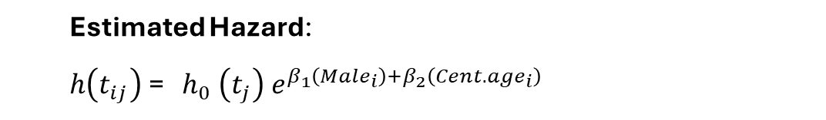
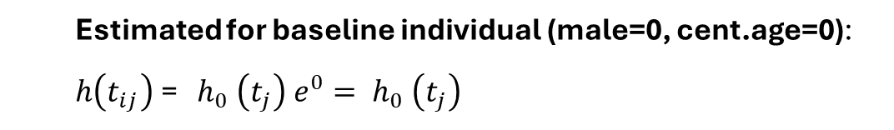
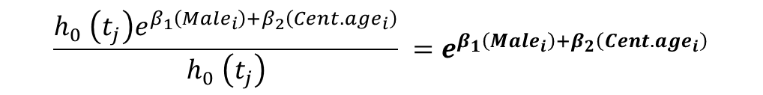
Risk Scores
Compare the risk of event occurrence for participants in the study vs. a “baseline individual”
  Baseline individual: values of predictors are zero
  → i.e., Female of median age
  Estimated Hazard:
  $h\left(t_{ij}\right)$= $h_{0} \left(t_{j}\right) e^{β_{1}\left({Male}_{i}\right)+β_{2}\left({Cent.age}_{i}\right)}$
  Estimated for baseline individual (male=0, cent.age=0):
  $h\left(t_{ij}\right)$= $h_{0} \left(t_{j}\right) e^{0}= h_{0} \left(t_{j}\right)$
$$\frac{h_{0} \left(t_{j}\right)e^{β_{1}\left({Male}_{i}\right)+β_{2}\left({Cent.age}_{i}\right)}}{h_{0} \left(t_{j}\right)} =e^{β_{1}\left({Male}_{i}\right)+β_{2}\left({Cent.age}_{i}\right)}$$
Notes:
Risk scores allow to summarise the effects of several predictors in the model, so they are attractive when there are complex models with multiple predictors: it may be difficult to appreciate the role of these predictors, and risk scores provide some help with that, as I will illustrate.
The purpose of risk scores is to compare the risk of event occurrence for participants in the study, compared to baseline individual, that is a participant that display value 0 in all the predictors.
Consider the example I used in the previous presentation where risk of death for lung cancer patients was predicted by patients’ age and sex. A “baseline individual” would thus be a female patient of median age, since I had centred age at the median. The risk score will thus try to assess the risk of death for patients of different sexes whose age vary around the median.
The risk scores can be calculated by considering this transformation of the Cox model equation. For individuals that have non-zero values in the predictors, the estimated hazard function is the exponentiation of the beta parameters multiplied by the predictors. For a baseline individual, the hazard function is just the baseline hazard function, since the predictors are 0 and the exponentiation of 0 is =1.
So, if we want to compare the hazard of an individual with non-zero values in the predictors vs. a baseline individual, we obtaine this division in the lower right part of the slide. But since the baseline hazard function is on the numerator and the denominator, they cancel each other out, so we estimate that the risk score of an individual with non zero values in the predictors is the exponentiation of sum of beta parameters by the respective predictor values.

Slide 7
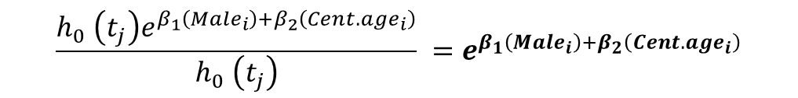
Risk Scores: Example
$$\frac{h_{0} \left(t_{j}\right)e^{β_{1}\left({Male}_{i}\right)+β_{2}\left({Cent.age}_{i}\right)}}{h_{0} \left(t_{j}\right)} =e^{β_{1}\left({Male}_{i}\right)+β_{2}\left({Cent.age}_{i}\right)}$$
 | Coef. | Exp(coef.) or HR | SE Coef. | z | p
Male | 0.51 | 1.67 | 0.17 | 3.07 | .002
Age (centred) | 0.02 | 1.02 | 0.01 | 1.85 | .065
$$e^{0.51\left({Male}_{i}\right)+0.02\left({Cent.age}_{i}\right)}$$
ID | Age | Male | Age Centred | Risk Score
1 | 74 | 1 | 11 | 2.015
2 | 68 | 1 | 5 | 1.819
7 | 61 | 0 | -2 | 1.615
Notes:
Here is an example of calculated risk scores from the lung cancer dataset. The results of the Cox regression are in the table on top. If we exponentiate the product of participant’s sex by 0.51, plus the product of participant’s centred age by 0.02, we obtain the different risk scores.
Please refer to the R scripts provided with the resources to follow the steps in analyses and in creating plots.
Here we see that participant #1, being male and 11 older than the median age, displays an increased risk score, wheareas participant #7, female and younger than the median age, displays a lower risk score.
It’s important to remember that risk scores are measured in relative, not absolute terms: they measure the relative level of hazard of a participant in comparison to the baseline hazard function.
Where these risk scores are particularly useful is in providing some intuition about the mechanisms at play: particularly in complex models, it is rare that few predictors have large effects that dominate over others. Consequently, it is difficult to assess the role of predictors from parameters alone. By looking at risk scores, we can get some idea about how the combination of predictor values together with their parameter estimates affect participants’ level of risk.

Slide 8
Recovered baseline function
Based on risk scores:
  Use total amount of remaining risk across intervals to compute baseline conditional probabilities.
  Kalbfleish & Prentice method, AKA product-limit method.
    Baseline function: values of predictors are all zero .
    Average function: values of predictors centered at sample means.
 | Coef. | Exp(coef.) or HR | z | p
Male | 0.53 | 1.70 | 3.18 | .001
Age (centred) | 0.01 | 1.01 | 1.25 | .211
ECOG performance (dichotomised) | 0.64 | 1.89 | 3.57 | <.001
Notes:
Starting from the risk scores, we consider these represent each participants’ observed risk score: they compare the level of risk of a participant to that of the baseline individual. Therefore, this provides an alternative metric for assessing the size of the risk set.
The idea is therefore that at the beginning of every time interval we can sum the total risk score for participants that are still in the risk set. In this way, it is possible to estimate the reduction in remaining risk. Using this total amount of remaining risk, it is possible to compute the baseline conditional probabilities.
There are two ways to estimate the baseline functions, which only differ in approximations. The most used is the one dubbed product-limit method.
Using this method, it is possible to estimate a baseline function, as well as an “average” function, whereby the values of the predictors are at the sample average. In practice, this means centering all the variables, even the dichotomous ones. This does not have relevance for the model parameters, so it is acceptable to do so and therefore recover the function of an “average” individual.
I will provide an example based on the lung cancer data. In this case I introduce a further predictor, the ECOG performance score given to the patient by a physician. This has been dichotomised to indicate that the patient is bedridden most of the time. Here are the results of the Cox regression.

Slide 9
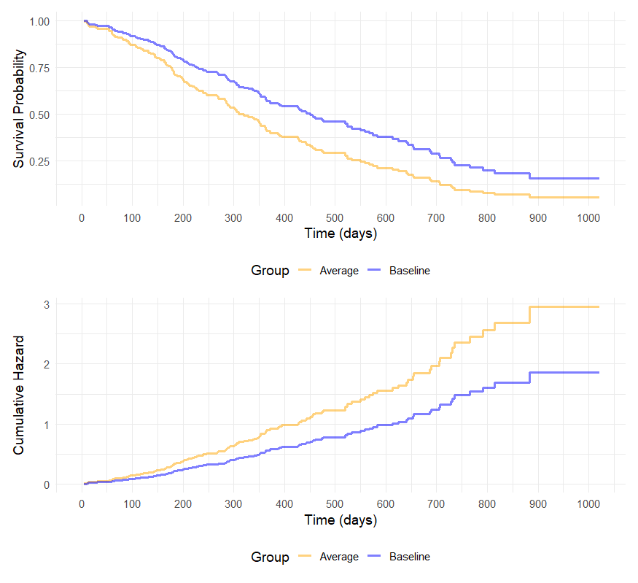
Recovered baseline function
    Baseline function:
    male=0;
    ECOG=0;
    (cent.)Age=0.
    Average function: male=.605;
    ECOG=.224; (cent.)Age=0.

Slide 10
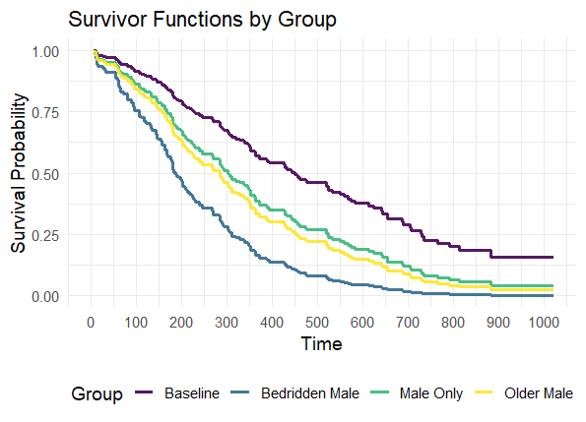
Prototypical individuals
Notes:
The utility of these methods lies also in the possibility of estimate the predicted functions of prototypical individuals that display meaningful and relevant combinations of predictor values.
The R scripts provide examples of how to estimate these functions

Slide 11
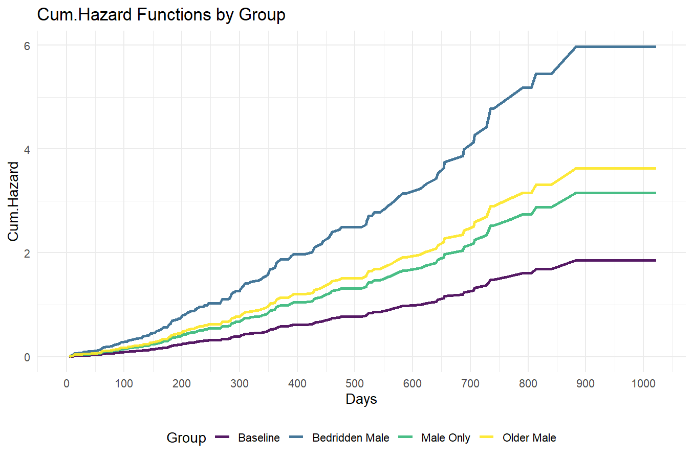
Prototypical individuals
Notes:
The utility of these methods lies also in the possibility of estimate the predicted functions of prototypical individuals that display meaningful and relevant combinations of predictor values.
The R scripts provide examples of how to estimate these functions

Slide 12
Cox Regression Model: Semi-parametric
  Key assumptions:
    A fitted log hazard function for each value of the predictors and their combinations;
    Fitted log hazard functions have an identical shape;
    The distance between log hazard functions is identical at every possible interval.
Notes:
There are other ways in which the Cox regression model may seem non-parametric: the model relies on the ordering of event occurrence. So even changing the time metric in uneven ways will not affect the results, as long as the order in which events occurred is maintained.
However, the model does make some assumptions, and here I remind them, expanding them for cases with more than one predictor
The last one states that the distance between the log hazards functions of the different combinations of predictor values are identical across time intervals. This assumption may be tenable in many cases, but there are some cases where it may not be.
There may be cases where, for example, the effect in reducing risk of death is more pronounced in some periods. It is possible to test the assumption of constant distance, and relax it.

Slide 13
Cox Regression Model: Interactions with Time
  Key assumptions:
    A fitted log hazard function for each value of the predictors and their combinations;
    Fitted log hazard functions have an identical shape;
    The distance between log hazard functions is identical at every possible interval.
    The latter can be relaxed, and thus allow predictor X time interactions:
  l$og h\left(t_{ij}\right)$= $log h_{0} \left(t_{j}\right) + β_{1}X_{i} +β_{2}X_{i}({Time}_{ij} −c)$
Notes:
I will not go into too details, but to illustrate how this assumption can be relaxed to allow interactions between predictor and time I will start from the Cox model expressed in terms of log hazard functions. Remember that tij indicates the time interval j for indivial i, so j indicates different time intervals, i indicates different inidividuals, participants. Lower case h0 indicates the baseline hazard function. So, the log of the hazard function for an interval j and individual i is the log baseline hazard function at interval j, plus the product of the individual’s value of predictor X and the beta1 coefficient.
To this initial equation we can add another term that represents the beta2 coefficient of the product of the value of predictor X and time. Note that we substract a constant c from time. This constant is used just to facilitate interpretation. We could decide to use the beginning of the study as our constant, that is, the constant will be time 0 when the study starts, so we can ignore it. We could choose other meaningful points, for example the sample’s median lifetime.
In this equation, while the beta1 coefficient represents how much the log hazard moves vertically for a unit increase in predictor X, the beta2 coefficient represents the how much the log hazard will further move with each increase in time. If the beta2 is positive, it means that log hazard function will increasingly move upward vertically with increasing time, if the beta2 is negative, it means the log hazard will increasingly move downward with increase in time units.

Slide 14
Cox Regression Model: Interactions with Time
  Key assumptions:
    A fitted log hazard function for each value of the predictors and their combinations;
    Fitted log hazard functions have an identical shape;
    The distance between log hazard functions is identical at every possible interval.
    The latter can be relaxed, and thus allow predictor X time interactions:
  l$og h\left(t_{ij}\right)$= $log h_{0} \left(t_{j}\right) + β_{1}X_{i} +β_{2}X_{i}({Time}_{ij} −c)$
  l$og h\left(t_{ij}\right)$= $log h_{0} \left(t_{j}\right) + β_{1}X_{i} +β_{2}X_{i} log ({Time}_{ij} −c)$
Notes:
Another popular option is to consider the interaction between the predictor X and the natural logarithm of time. This has some useful qualities, since logarithm are useful in representing changes in the magnitude of values. However, one needs to be careful not to select values of time and the constant c that returns 0, since the logarithm of zero will return negative infinity.
There are other ways in which interactions between predictors and time can be expressed, for example it may be possible to divide time piecewise
into “epochs” that can have different durations, create dummies for these epochs and estimate coefficients for each one of these. For example, if we consider the occurrence of shareholders selling their shares, we can test if the effect of a predictor on this hazard changes during “epochs” that correspond to before and after a serios of announcements.
The references with these resources provide more examples and details.

Slide 15
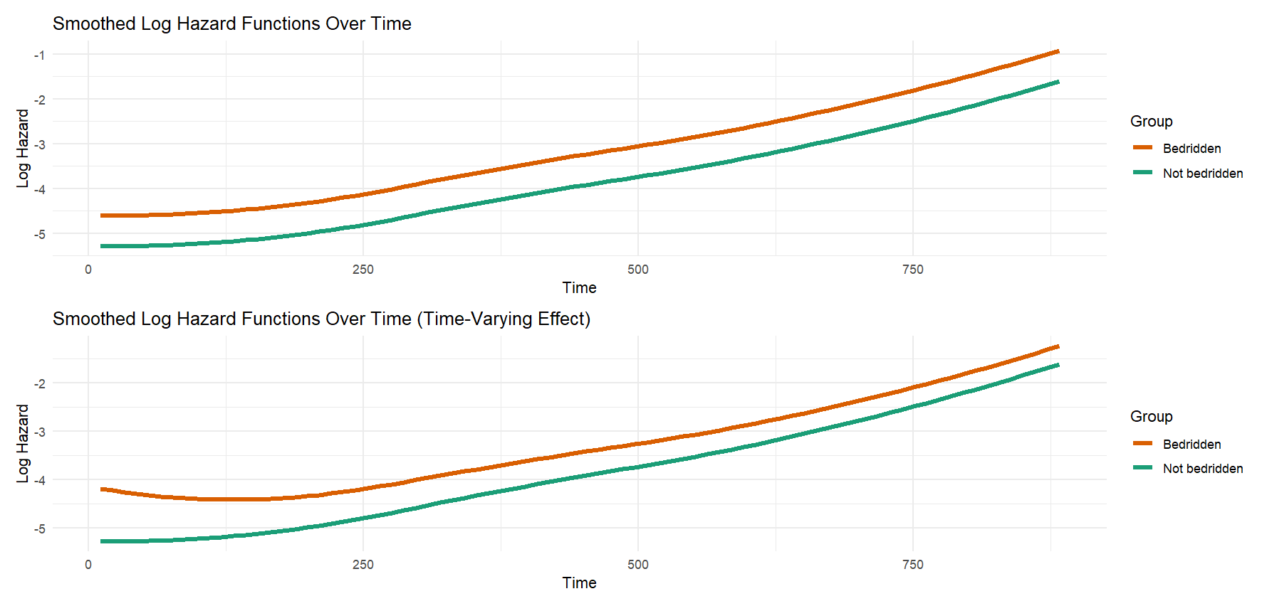
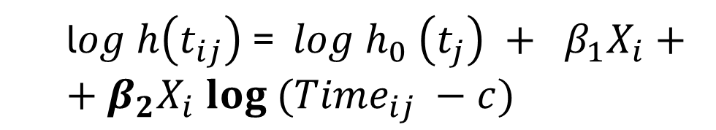
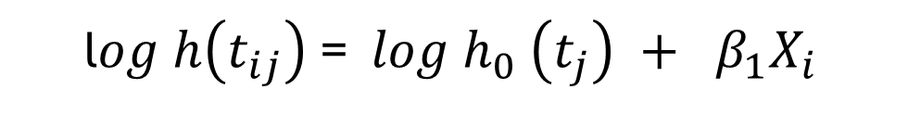
Cox Regression Model: Interactions with Time
  l$og h\left(t_{ij}\right)$= $log h_{0} \left(t_{j}\right) + β_{1}X_{i}$
  l$og h\left(t_{ij}\right)$= $log h_{0} \left(t_{j}\right) + β_{1}X_{i}++β_{2}X_{i} log ({Time}_{ij} −c)$
Notes:
The references with these resources provide more examples and details.

Slide 16
Summary
Cox Regression Model is Semi-Parametric
  No assumptions concerning the baseline function
  However, there are key assumptions, particularly the proportionality of hazards.
  The latter can be relaxed to allow time varying effects of predictors
  Non-parametric risk scores allow to estimate relative hazard of individual cases, as well as recover functions of baseline and prototypical individuals.

Slide 17
www.ncrm.ac.uk

